Slide 1
Logos, Ethos, and Pathos
The Rhetorical Triangle
or
The Aristotelian Appeals

Slide 2
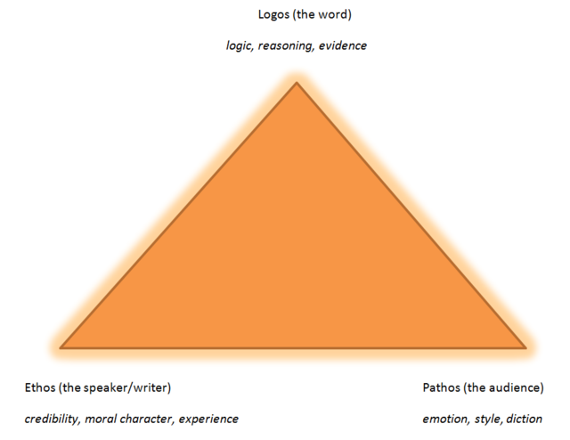
These three appeals make up the basis for persuasion
They are crucial to the creation of speeches
As well as writing

Slide 3
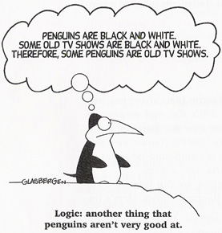
Logos

Slide 4
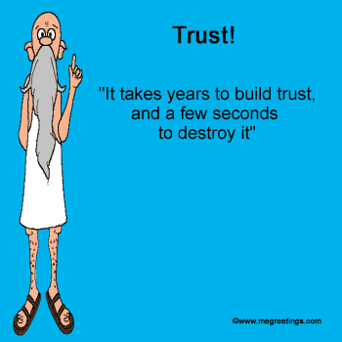
Ethos

Slide 5
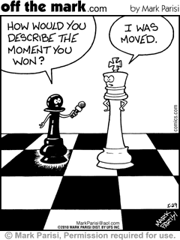
Pathos

Slide 6
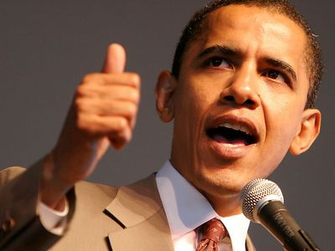
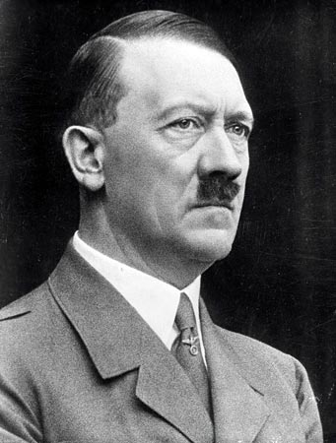
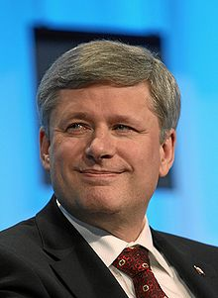
They work together
Each Appeal works together to persuade:
Too little Logos ---- >
Too little Ethos ---- >
Too little Pathos ---- >

Slide 7
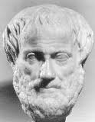
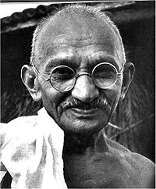
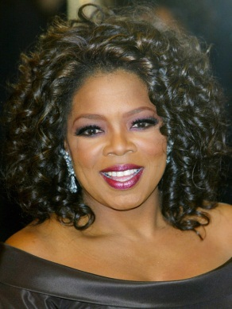
One can stand out
They rarely are equal:
Logos ---- >
Ethos ---- >
Pathos ---- >

